Slide 1
PHOTO EDITING
CSE 611 – MS Project Development
Professor – Jinjun Xiong
TA – Amir Nassereldine

Slide 2
Team Members
Manikanta Kalyan Gokavarapu
Mallikharjuna Rao Annam
Rakesh Kumar Gavara
Ruthika Juluri
Khyathi kunuthur

Slide 3
Overview
The Photo Editor project is a web application designed to enhance and manipulate digital images. It allows users to edit and enhance their photos with a variety of tools and features, including cropping, resizing, adjusting brightness and contrast. The software is user-friendly, offering an intuitive interface and the ability to undo or redo actions. The project is aimed at individuals who want to improve their photos or use them for personal or professional purposes. The end goal of the project is to provide users with a comprehensive tool that can help them create high-quality images with ease.
3

Slide 4
Features
Resize and Crop
Photo colleague
Image Format conversion
Passport photo creation tool
Noise Removal
Brightness/Contrast
4

Slide 5
Product Functions
The photo editor is a comprehensive tool for enhancing and manipulating digital photos. The main functions that will be built into the product include:
Cropping: Users will be able to crop their photos to remove unwanted elements or to focus on a specific area.
Resizing: Users will be able to change the dimensions of their entire image to better fit their intended use, whether it's for social media, printing, or other purposes.
Brightness/Contrast Adjustment: Users will be able to adjust the brightness and contrast of their photos to improve the overall look and feel.
Upload/Download: As part of UI there will be a couple of buttons for Users to Upload images from their local system and download the same post image processing.
5

Slide 6
Product Functions
Face Detection: We extract the head image of users from their uploaded full photo.
Photo Collage: Users can submit multiple images, which we then combine into a single image or layout.
Image Format Conversion: Users can convert their images into the desired format, such as JPEG, PNG, and more.
Passport Photo Creation tool: Users will get digital passport size images that meet the precise passport image requirements like size, background color, and head position of their country of choice.
Noise Removal: Users can get sharp and clean images by removing unwanted distortions or noise.
6

Slide 7
Comparing similar photo editing products in the Market
Canva provides basic photo editing tools such as crop, resize, brightness and contrast adjustments but does not provide tools such as image format conversion, passport size photo creation and face detection.
Ribbet provides a range of basic photo editing tools, including crop, resize, color correction and collages but does not provide tools such as but does not provide tools such as image format conversion, passport size photo creation and face detection.
BeFunky provides a range of basic photo editing tools, including crop, resize, color correction and collages but does not provide tools such as image format conversion, passport size photo creation and face detection
Adobe Photoshop Express provides basic photo editing tools, such as cropping, resizing, collage and color correction but does not provide tools such as image format conversion, passport size photo creation and face detection.
PicsArt also provides a range of photo editing tools, including crop, resize, collage and color correction but does not provide tools such as image format conversion, passport size photo creation and face detection.
7

Slide 8
Specific Requirements
User Requirements
The website should have an easy and user- friendly interface to navigate between different available options.
Users should be able to upload, view and edit the photos on the website and use the tool and edit them easily.
The website should have different options such as resizing, format conversion, color adjustments, cropping, color correction, collage creation, face detection, passport size creation tool.
Users should be ensured about privacy of the data and that measures are in place to protect their photos.
They should be able to download the edited image in their required format such as jpg, png, jpeg, etc.
Users should be provided with high quality images without much pixel reduction or loss of quality.
The website should load quickly and perform smoothly while handling complex or large size files.
The website should be accessible to the users via mobile or web browsers and should be responsive enough in either case.
8

Slide 9
Specific Requirements
System Requirements
The website should run smoothly on standard hardware including laptops, desktops, tablets and mobile devices etc.
The website should run on all types of operating systems such as Linux, Mac OS and Windows.
It should be hosted on IBM cloud and required resources need to be assigned properly for the deployment of applications.
The website is developed using the modern programming languages like React Js, Python, Django and JavaScript.
The photo editing functionality is achieved using opencv libraries and respective image processing techniques.
The website should have better network connectivity to upload images and to ensure that they are processed properly.
The website should be optimized properly to perform image processing techniques and face detection algorithms to perform photo editing.
Proper logging, error and exception handling should be handled to accommodate any issues with the website.
9

Slide 10
Specific Requirements
Interface Requirements
The Photo editing application is a Single Page Application (SPA) built by using React and Python as tech-stacks.
This SPA will have several cards with required features such as resize, crop, and image conversion and will also have a feature to download the image to your local.
Each card will have a feature title and a short description of what the feature does which helps the user to select.
Users can select any feature by selecting or clicking on the feature cards.
Upon selection, the component related to the selected feature will be loaded. Allowing users to use the feature he/she selected.
Toasters will be used to handle the errors in the interface.
10

Slide 11
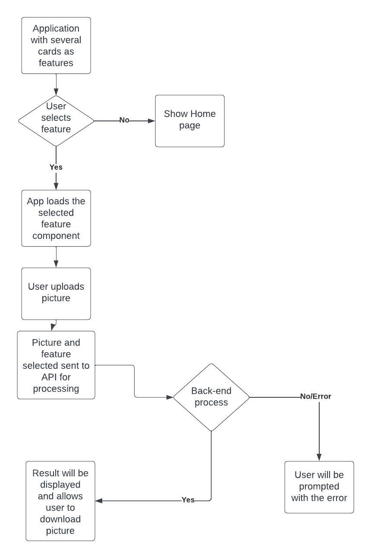
Front End WorkFlow
11

Slide 12
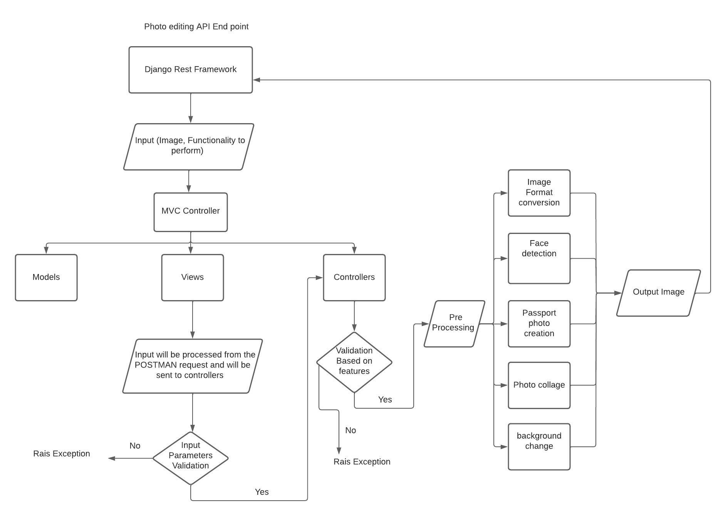
Backend Work Flow

Slide 13
Thank You

